Slide 1
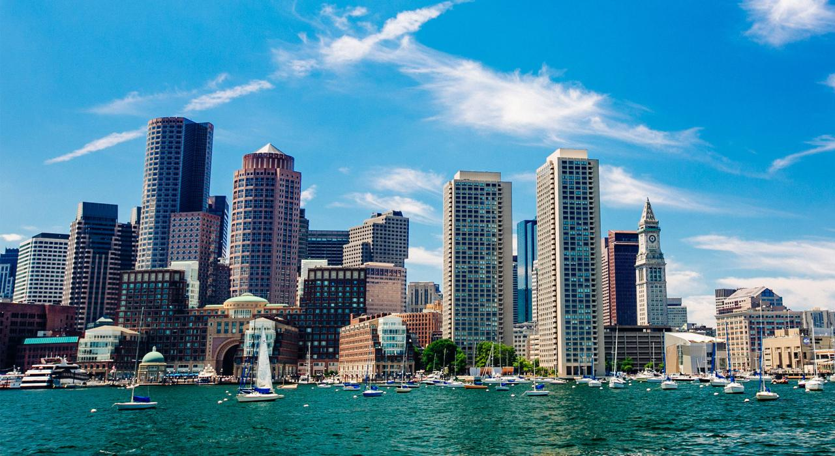
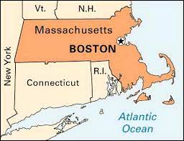
Boston Museum of Science
Ms. Robinson, Mr. Miller, Ms. Miller, and Mr. Raineri

Slide 2
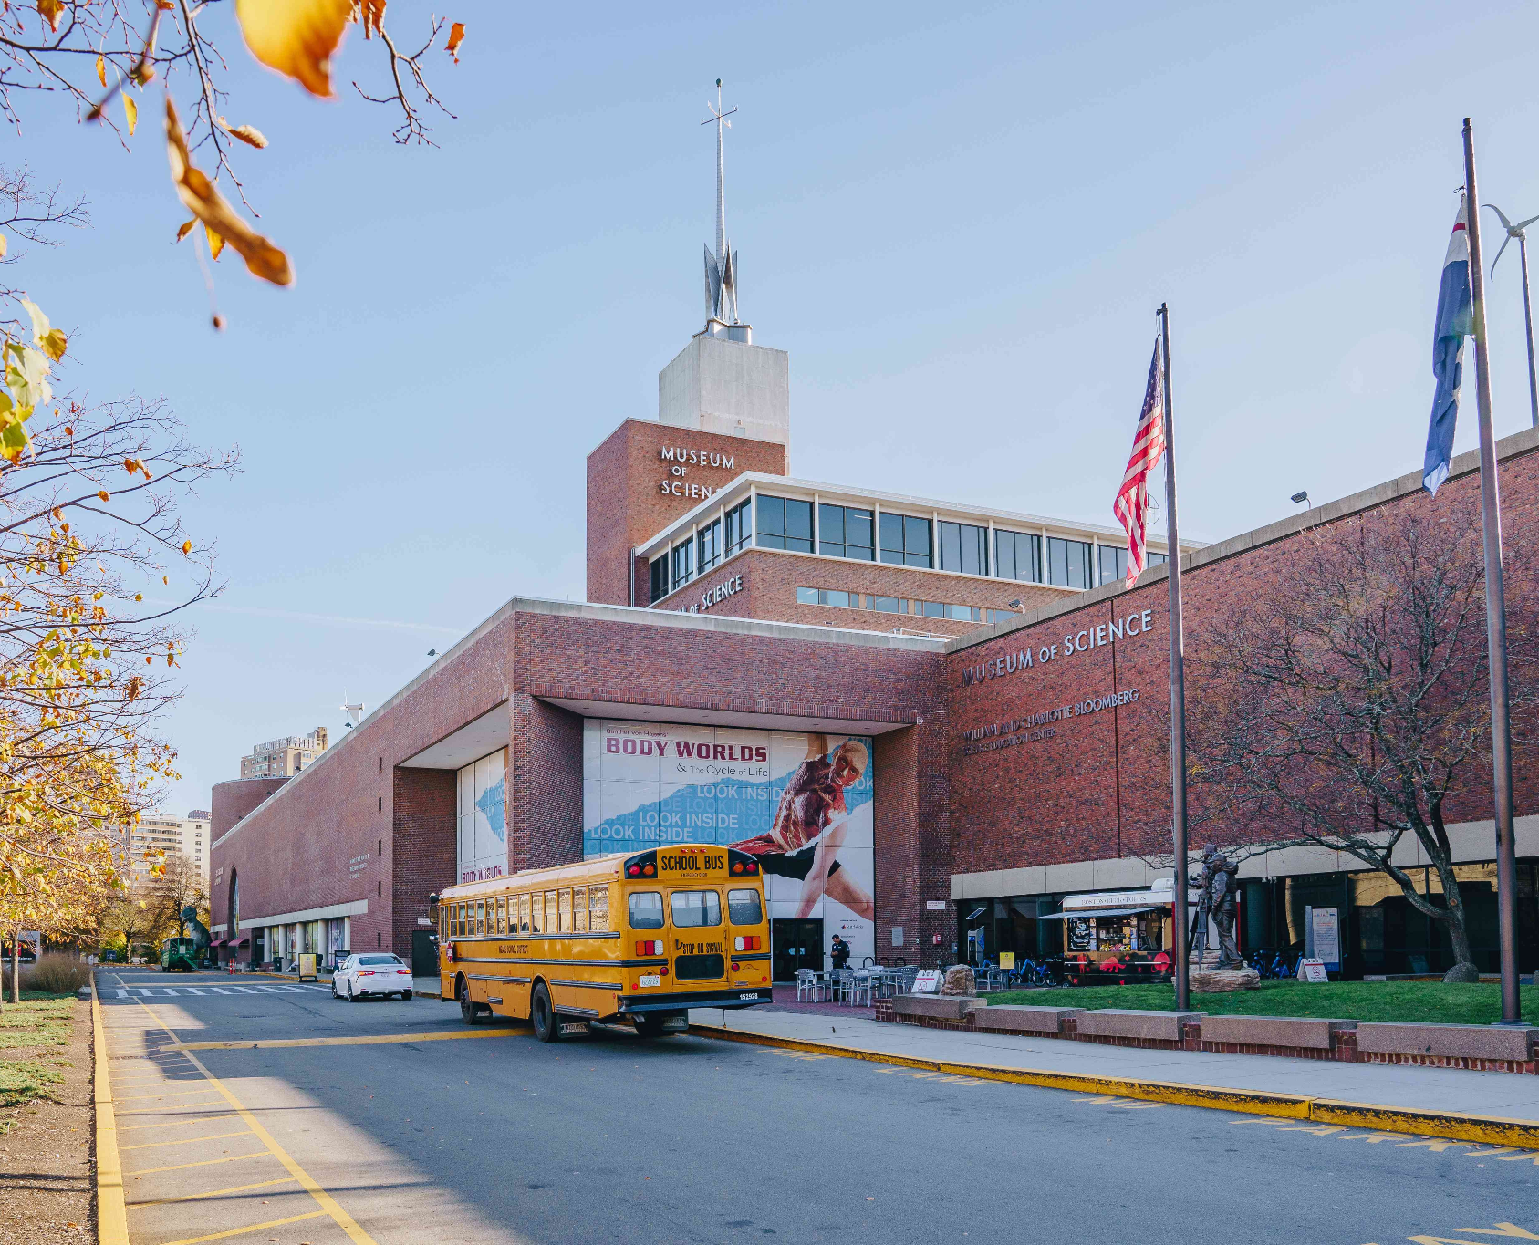
The Process
How we came up with the field trip idea
David looked up science museums in the area, not many
Both science and math components
1st accredited zoo to be in a museum by the Association of Zoos and Aquariums (AZA)
Insert museum pictures

Slide 3
Infographic
Animal Rehab Center
Hall of Human Life
Mathematica
Free Time
Tesla Coils, anatomy and physiology, physics exhibit, virology/epidemiology, etc.
Total Cost
Overnight Stay
RSVP By 03/13

Slide 4
Notes:
The digital video is going to go here.

Slide 5
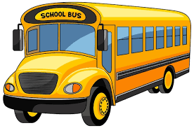
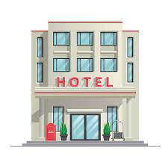
Weekend/Plans
April 13:
Provide breakfast for your kids Saturday morning
Get to the school Saturday morning no later than 8 am
Travel Saturday for 5 hours on a bus.
School lunch will provided on the bus
Go to museum Saturday afternoon
Arrive at hotel Saturday night
Dinner will be provided once we arrive
April 14:
Complimentary hotel breakfast Sunday morning
Travel back Sunday after breakfast
Arrive to pick up your kids by 3pm Sunday

Slide 6
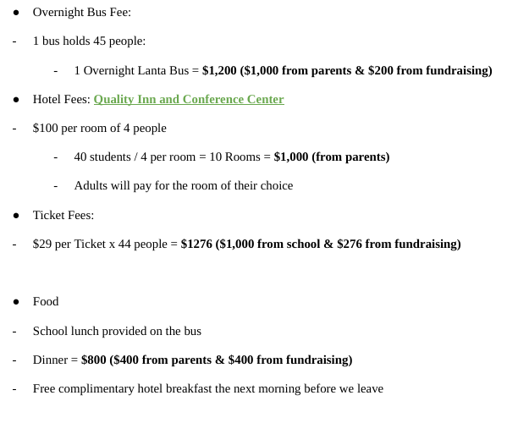
Budgeting for 44 Total People (40 students, 2 teachers, 2 chaperones)
Parents - $2,400 ($60 per parent)
$25 - Hotel
$25 - Bus
$10 - Food
School - $1,000
Fundraising - $876
Total: $4,276
Fundraising:
Bake sale (Students make the food)
Duct Tape to Pole

Slide 7
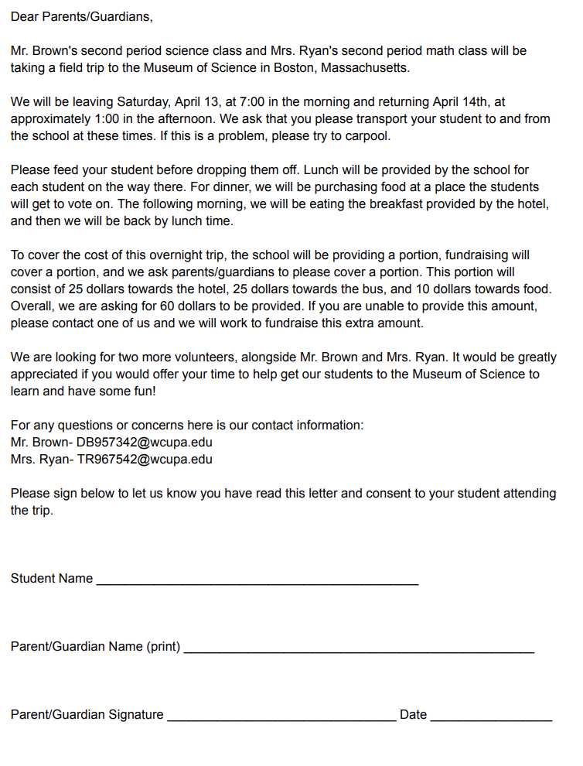
Parent Letter
One science and one math class going
The dates we are going
Transportation provided and needed
How the students will be fed
Costs and what money will be provided and what amount will be needed
Looking for volunteers
Teachers emails
Parent consent slip

Slide 8
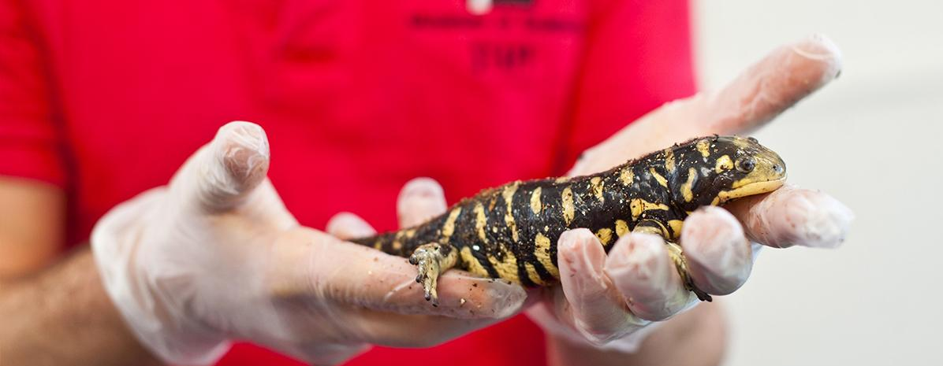
Curriculum Connections
Live Animal Care Center:
3.4.6-8.E Collect, analyze, and interpret environmental data to describe a local environment.
Each student will:
Measure the cuteness of 5 animals on a scale of 1-100
Compile their data into a shared Google Sheet
Analyze the data using various graphs to see which animal the class thinks is the cutest
Notes:
D

Slide 9
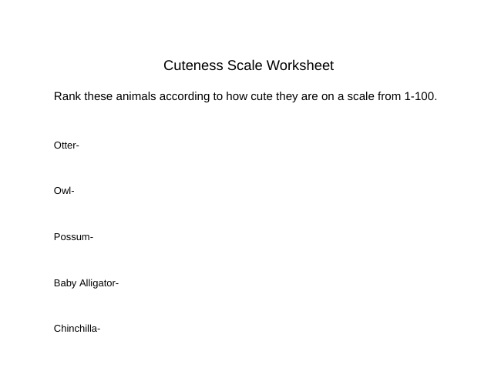
79
60
30
20
85
Notes:
D

Slide 10
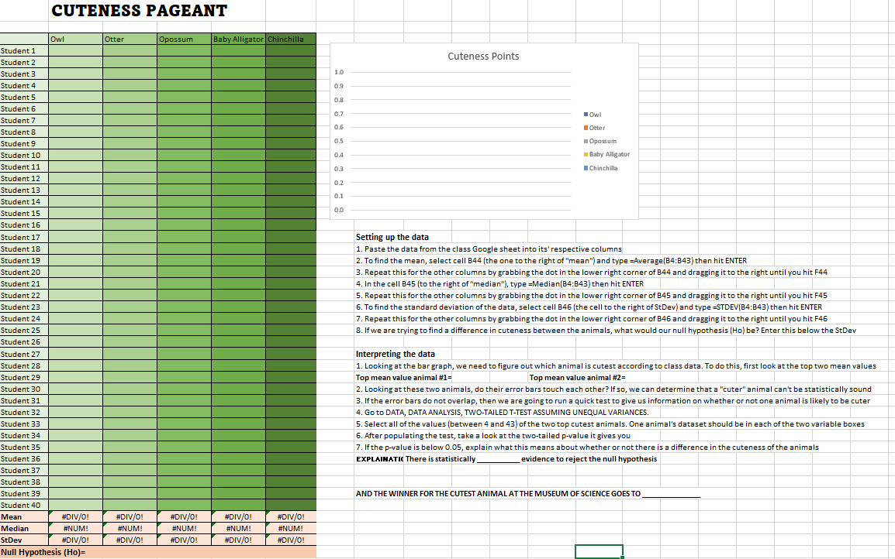
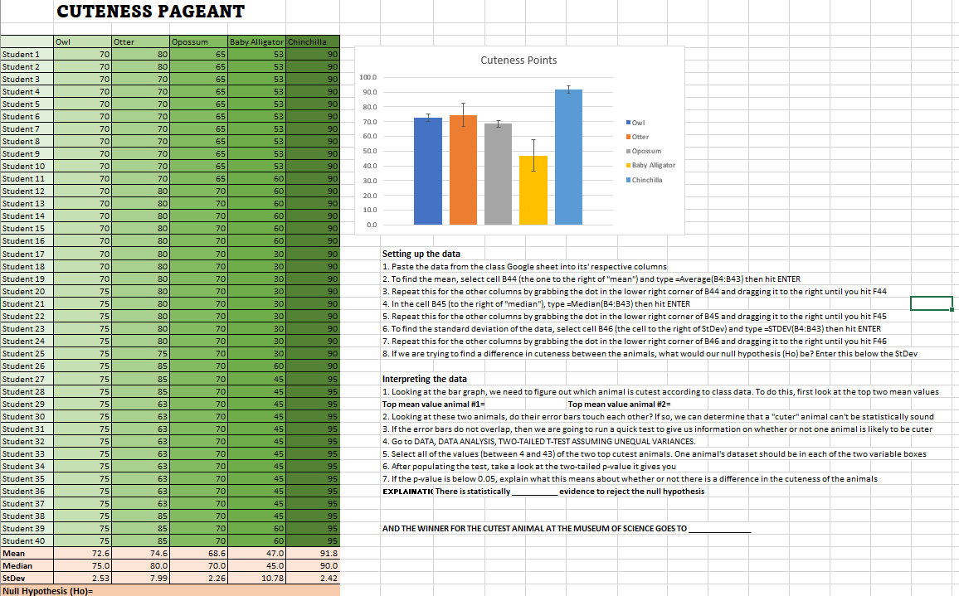
Notes:
D

Slide 11
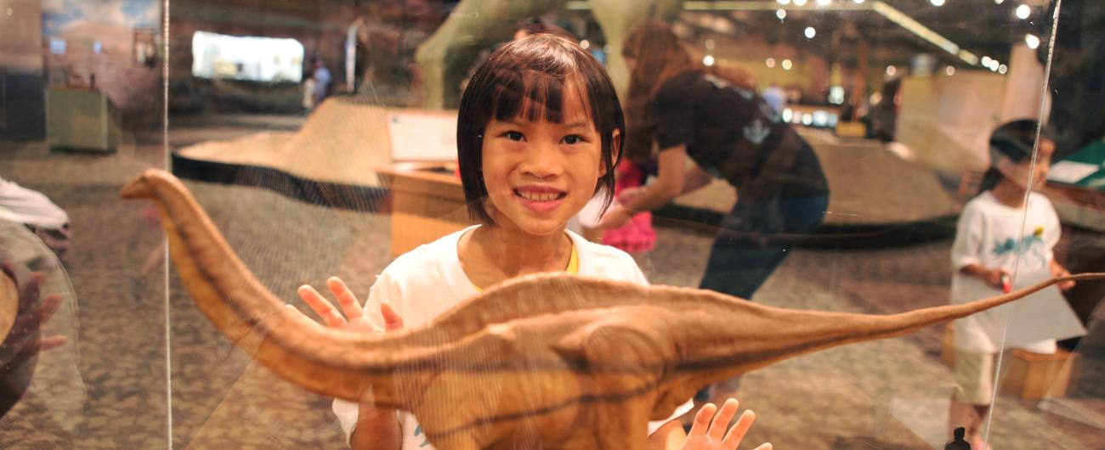
Dinosaurs: Modeling the Mesozoic:
3.5.6-8.C Hypothesize what alternative outcomes might have resulted had a different technological solution been selected.
6.5.6-8.O Interpret the accuracy of information collected.
Each student will:
Hypothesize which dinosaur had the highest trophic level just by looking at the life-size models
Read the descriptions of each dinosaur to see if they should accept or reject their hypotheses

Slide 12
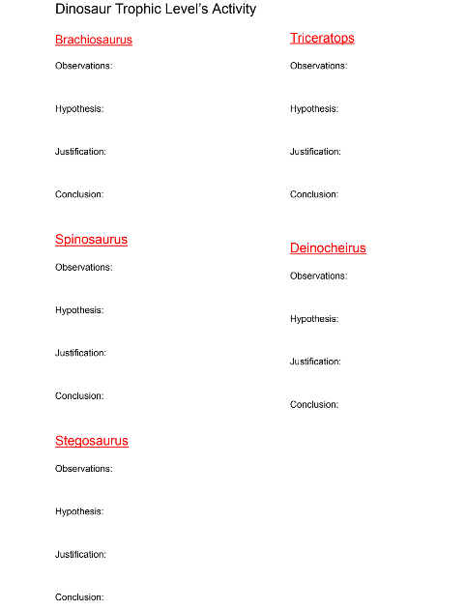

Slide 13
The Hall of Human Life
CC.2.2.6.B.2 Understand the process of solving a one-variable equation or inequality and apply it to real-world and mathematical problems.
CC.2.2.7.B.3 Model and solve real-world and mathematical problems by using and connecting numerical, algebraic, and/or graphical representations.
Each student will:
Participate in an interactive activity where they will contribute their own data to learn about themselves
Make up their own one-variable word problem based on one of the interactive components
Give their question to another student next week to solve
Example problem: If the human body has 206 bones, but Carl breaks 5 bones in each of his feet, how many bones aren’t broken? 206 - (5*2) = x. 206-10 = x x = 196

Slide 14
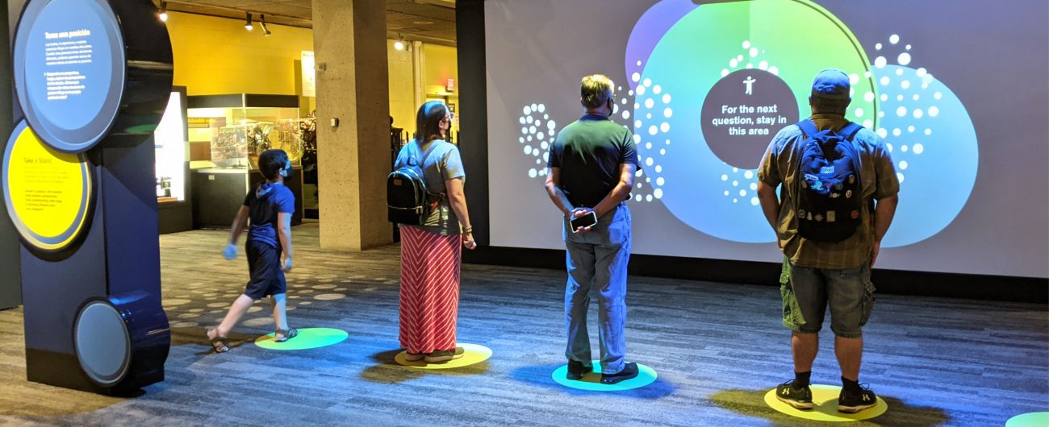
Project Vaccine
3.4.9-12.B Apply research and analytical skills to evaluate the conditions and motivations that lead to conflict, cooperation, and change among individuals, groups, and nations.
Math Practice #3: Construct viable arguments and critique the reasoning of others.
Each student will:
Participate in another interactive activity where they will position themselves along a continuum which asks opinionated questions regarding vaccines
Hear how other visitors answered the same questions
Re-evaluate their thinking

Slide 15
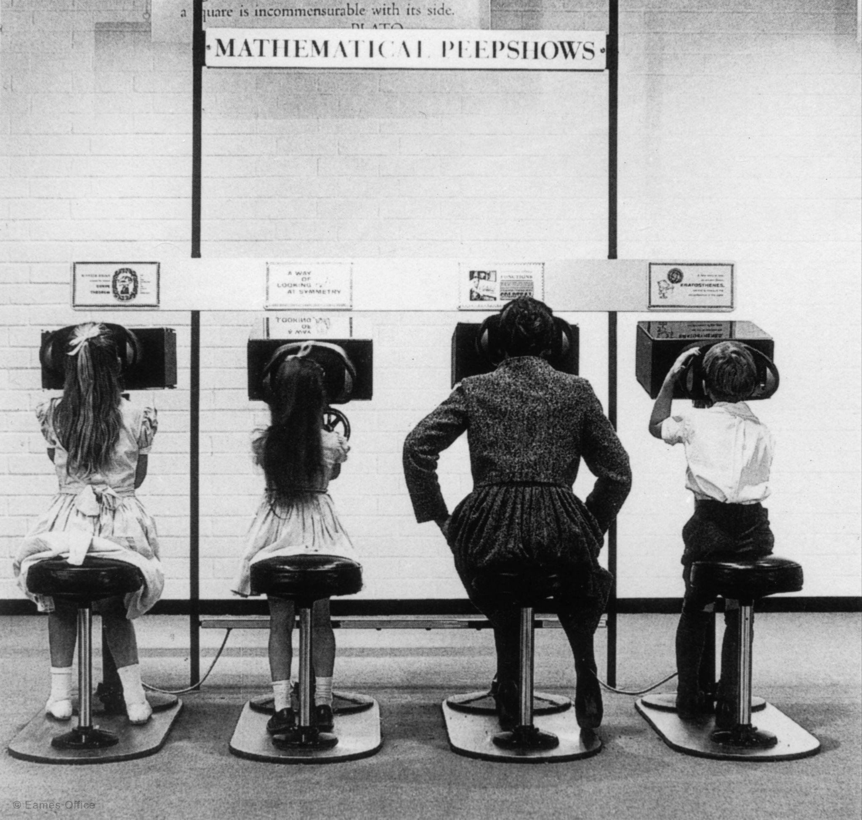
Mathematica
CC.2.4.6.B.1 Demonstrate an understanding of statistical variability by displaying, analyzing, and summarizing distributions.
CC.2.2.6.B.1 Apply and extend previous understandings of arithmetic to algebraic expressions.
Each student will:
Participate in various interactive activities on their own
- Find the Fibonacci series of numbers in the seeds of a sunflower
*Although many of our students haven’t learned about bigger mathematical concepts yet, we will still ask our students to try their best.

Slide 16
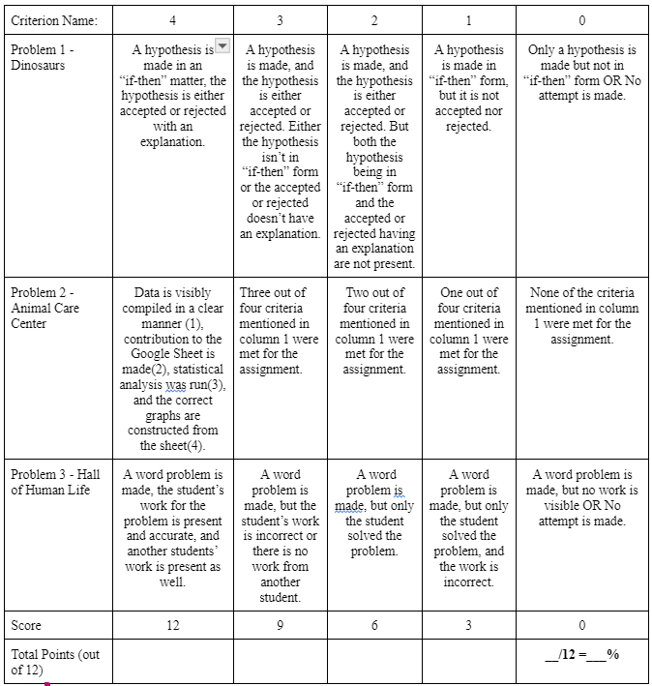
Assessment Plan
Dinosaurs: Modeling the Mesozoic
Live Animal Care Center
The Hall of Human Life
(Insert Rubric Here)

Slide 17
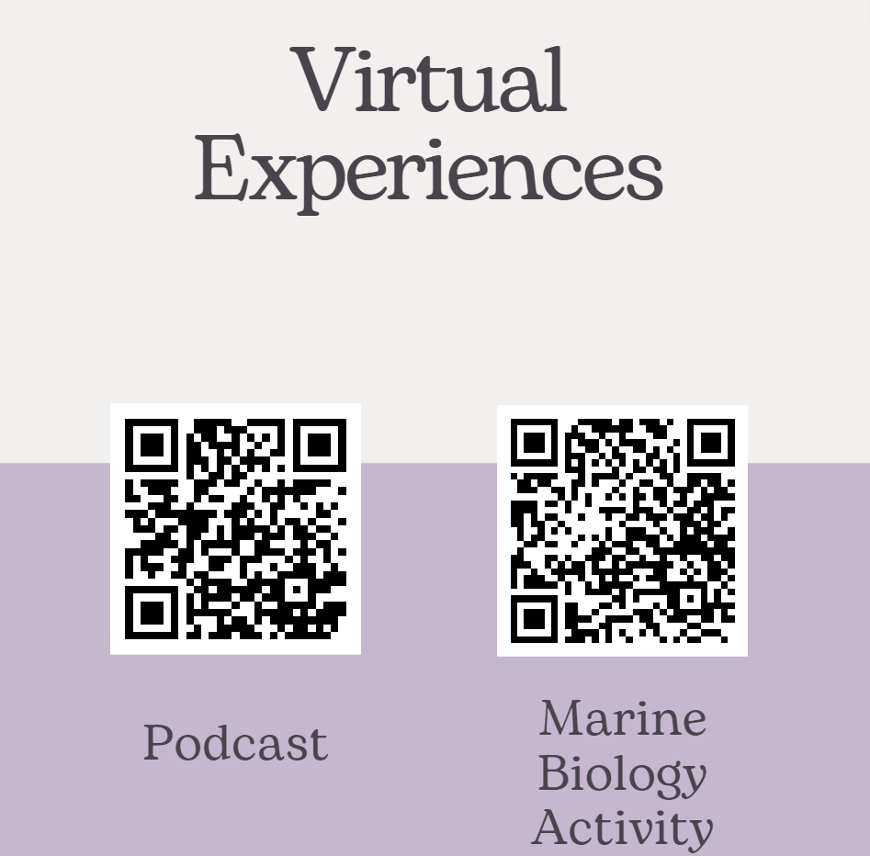
Virtual Experience
https://www.mos.org/pulsar/not-a-dinosaur
https://virtualexhibits.mos.org/sounds-of-the-arctic/
Sounds of the arctic
1:22-2:34
https://www.mos.org/pulsar/not-a-dinosaur
Notes:
Podcast: Start at 1:22 and end at 2:34

